Slide 1
Mid term “exam”
CSI 3150

Slide 2
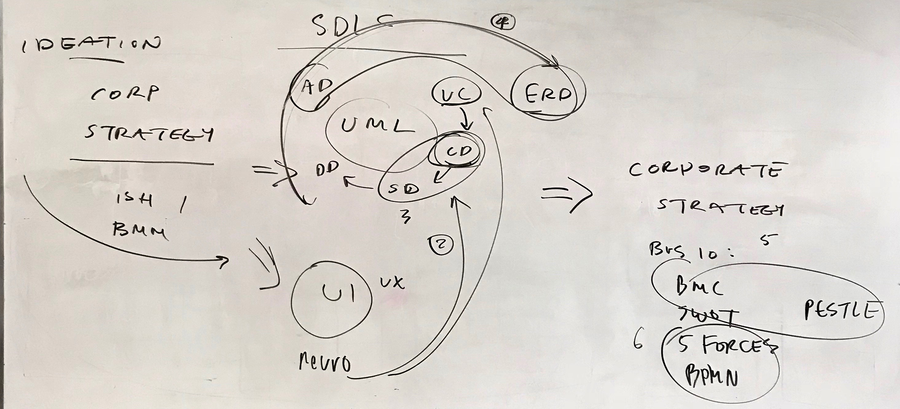
rubric
Presentation, each member must present
Exhibit the complete cycle of analyses, per this diagram:

